Slide 1
B.A.C
Blood Alcohol Content

Slide 2
Find your blood alcohol level by using the chart below.
One drink is considered:
(1) 12 fl oz beer
(1) 5 fl oz glass of wine
(1) 1.5 fl oz shot of hard liquor

Slide 3
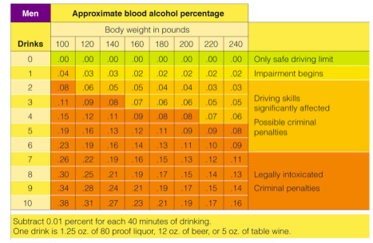
Men BAC

Slide 4
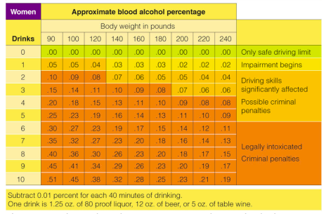
Women BAC

Slide 5
Blood Alcohol Calculator
http://bloodalcoholcalculator.org/#LinkURL

Slide 6
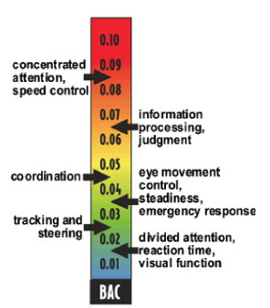

Slide 7
